Slide 1
Approximation Algorithms
Learning Objectives
To understand Non-deterministic algorithm.
To understand relation between NP-Hard and NP-complete
To understand the approximation algorithms.
To understand Need for Approximation algorithms.
To understand basic approximation algorithms.

Slide 2
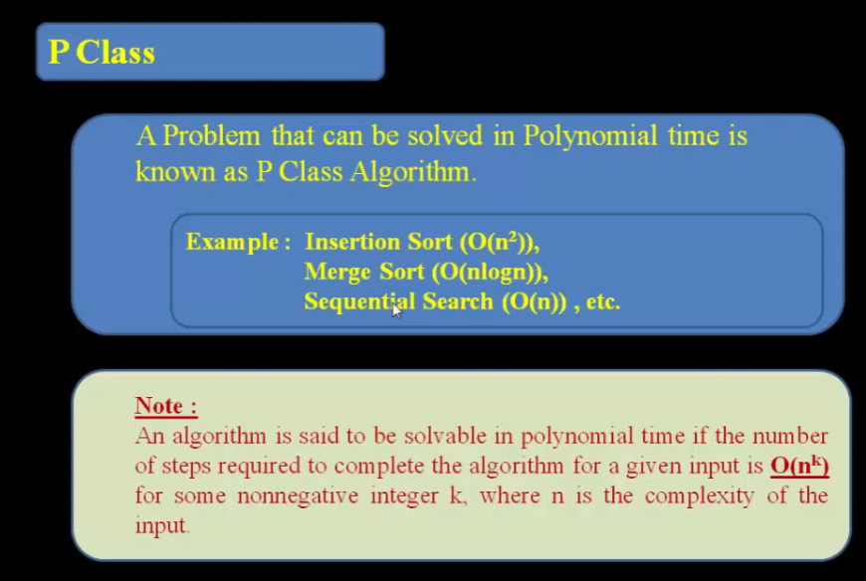
Complexity Class

Slide 3
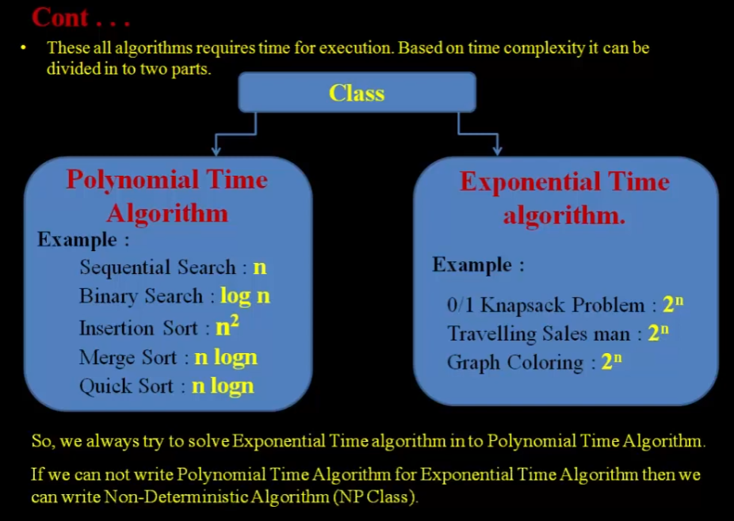
Complexity Class

Slide 4
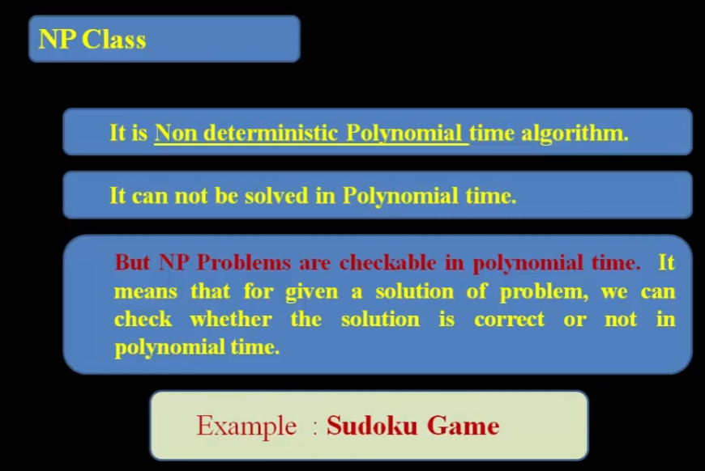
Complexity Class

Slide 5
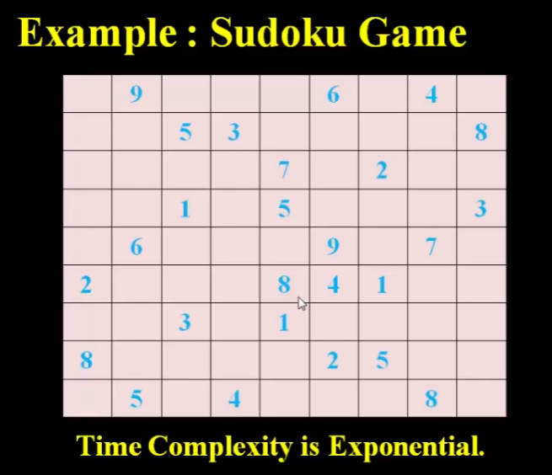
Complexity Class
To write each row and column from 1 to 9 without repetition

Slide 6
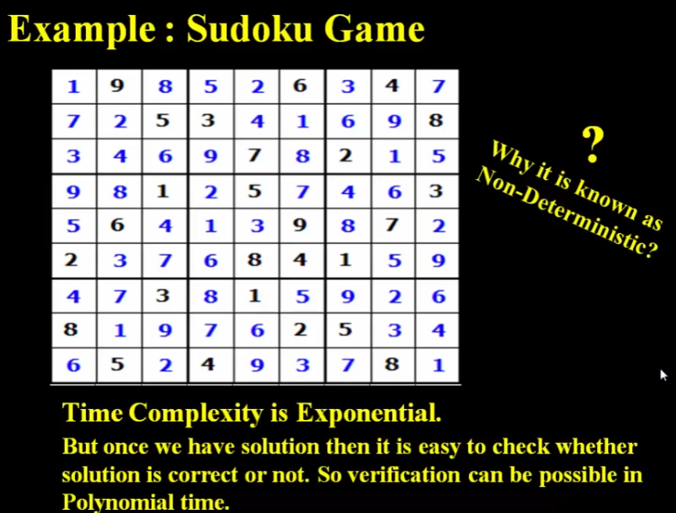
Complexity Class

Slide 7
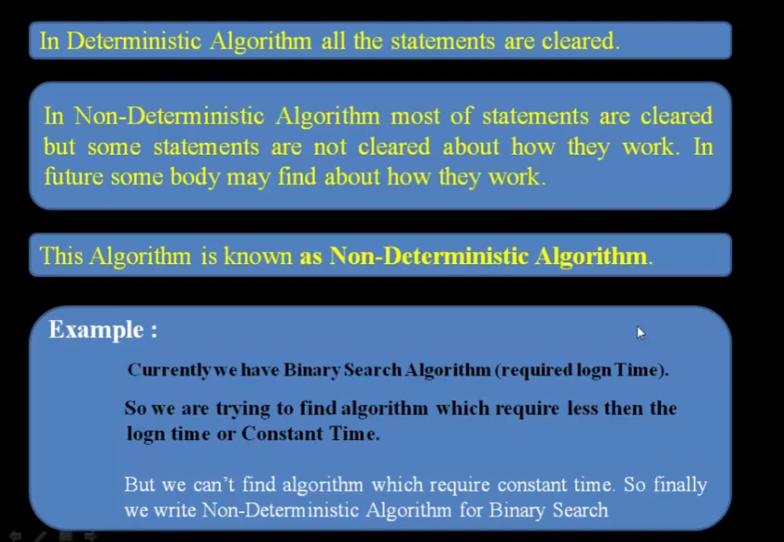
Non-Deterministic Algorithm

Slide 8
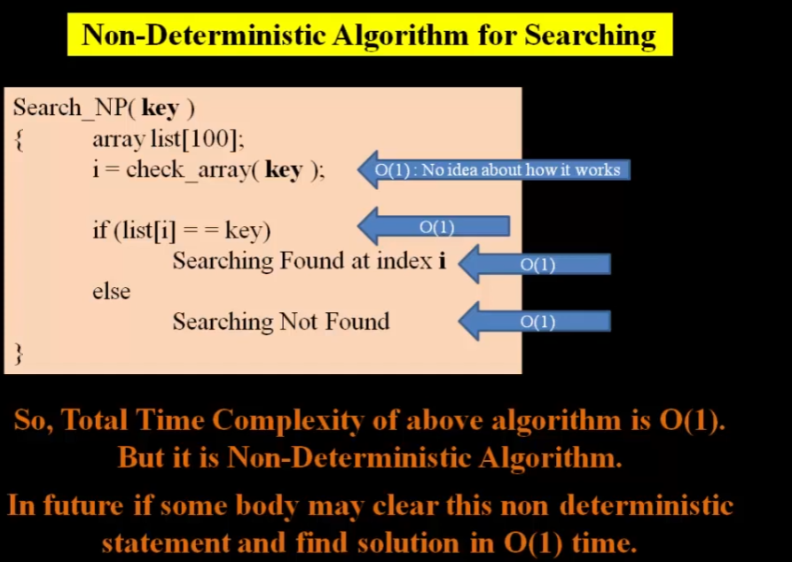
Non-Deterministic Algorithm
No comparing, searching

Slide 9
Complexity Class
For NP-complete problems: there is no polynomial time algorithm to find an optimal solution.
These algorithms are exponential in nature. When input size is increases the amount of resources become larger and larger…
The solution of NP-complete problems are very difficult.

Slide 10
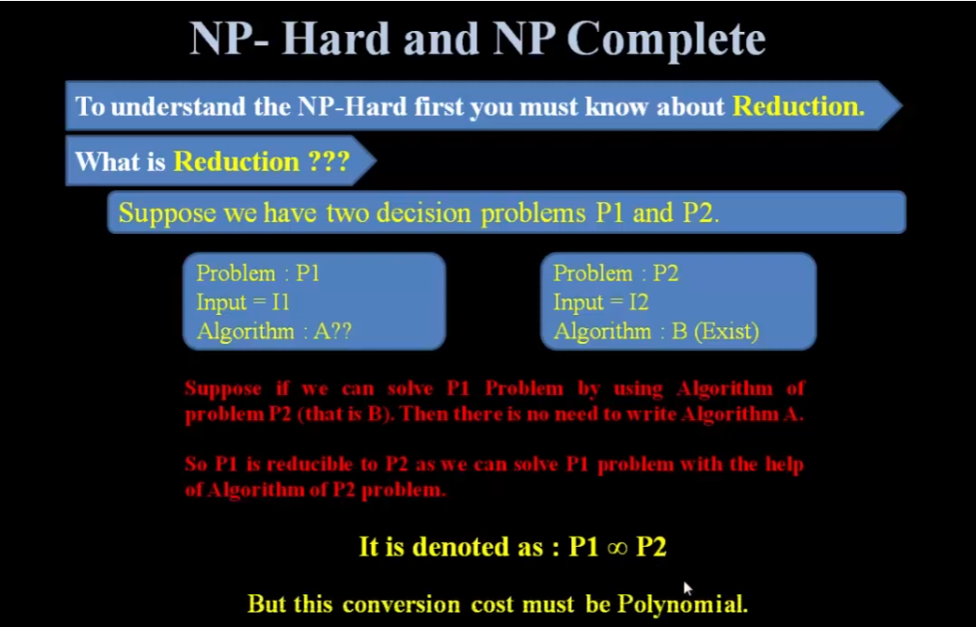
Complexity Class

Slide 11
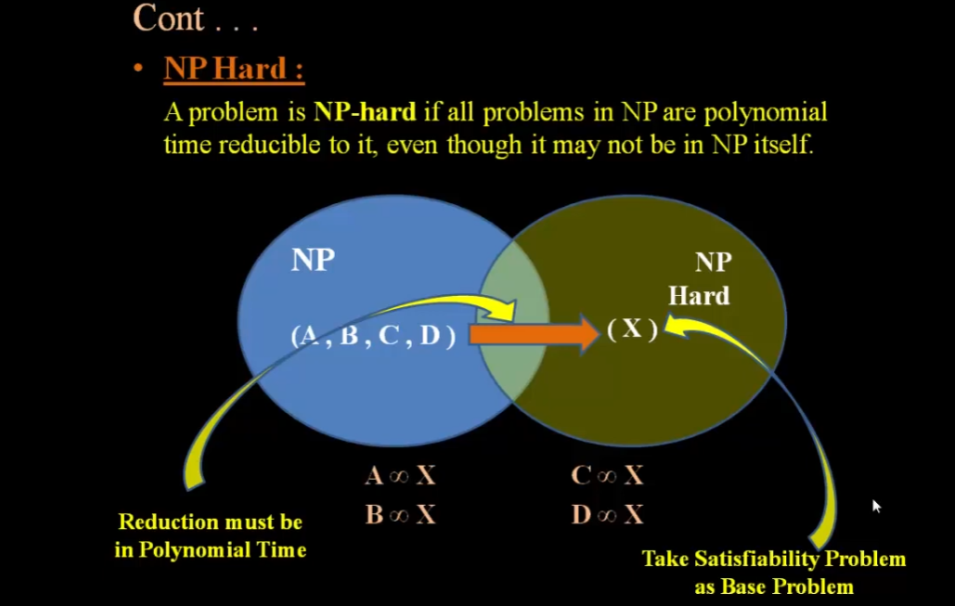
Complexity Class

Slide 12
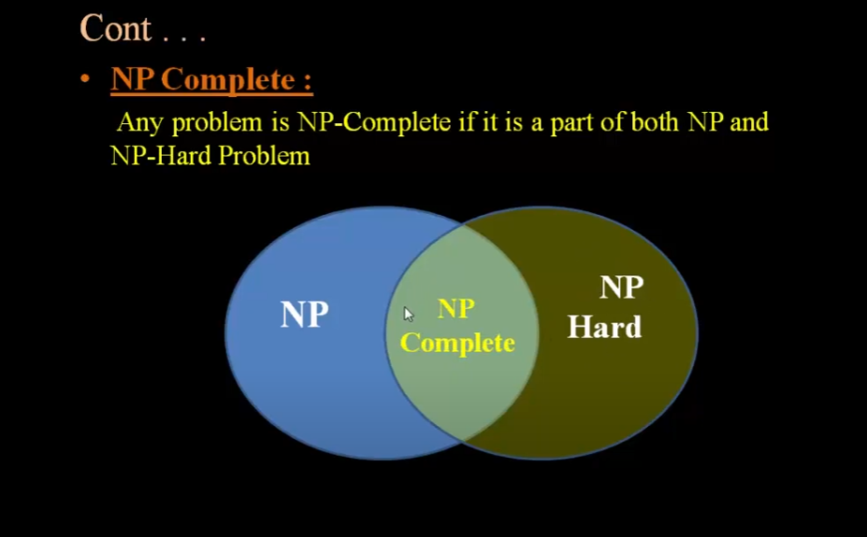
Complexity Class

Slide 13
Optimization Problems
In computer science, an optimization problem is the problem of finding the best solution from all feasible solutions.
The objective may be either min. or max. depending on the problem considered.
A large number of optimization problems which are required to be solved in practice are NP-Hard as well as NP-complete.
For such problems, it is not possible to design algorithms that can find exactly optimal solution to all instances of the problem in polynomial time in the size of the input.
Exponential time complexity, NP-complete problems are:
TSP: minimize the cost of the route
0/1 Knapsack problem: maximize the profit
Vertices cover problem: minimize the number of vertices

Slide 14
Address NP-complete problems
How to solve NP-complete problems?
Brute-force algorithm
Guaranteed to find optimal solution
No guarantees on running time.
Heuristics
Guaranteed to run in polynomial time
No guarantees on quality of solution.
Approximation algorithms
Guaranteed to run in polynomial time
Guaranteed to find near-optimal solution

Slide 15
Brute-force algorithm
Brute-force algorithm
In popular Travelling Salesman Problem Solutions:
The Brute Force approach, also known as the Naive Approach, calculates and compares all possible permutations of routes or paths to determine the shortest unique solution.
To solve the TSP using the Brute-Force approach, you must calculate the total number of routes and then draw and list all the possible routes. Calculate the distance of each route and then choose the shortest one.
This is the optimal solution.

Slide 16
Heuristic techniques
A heuristic technique, is any approach to problem-solving that uses a practical method or various shortcuts in order to produce solutions that may not be optimal but are sufficient given a limited timeframe or deadline.
Heuristics methods are intended to be flexible and are used for quick decisions, especially when finding an optimal solution is either impossible or impractical and when working with complex data.
Analysts in every industry use rules of thumb such as intelligent guesswork, trial and error, the process of elimination, past formulas, and the analysis of historical data to solve a problem.

Slide 17
Heuristic techniques
For example, Fast Food ABC expanded its operations to Bangladesh and its stock price soared. An analyst noted that Bangladesh is a profitable venture for all fast-food chains.
Therefore, when Fast Food XYZ announced its plan to explore the Bangladesh market the following year, the analyst wasted no time in giving XYZ a “buy” recommendation.
Although his shortcut approach saved reviewing data for both companies, it may not have been the best decision. Fast Food XYZ may have food that is not appealing to Bangladeshi consumers.

Slide 18
Heuristic techniques
In popular Travelling Salesman Problem Solutions:
In TSP, This is perhaps the simplest TSP heuristic. The key to this method is to always visit the nearest destination and then go back to the first city when all other cities are visited.
To solve the TSP using this method, choose a random city and then look for the closest unvisited city and go there. Once you have visited all cities, you must return to the first city.

Slide 19
Approximation Algorithms
An approximation algorithm returns a solution to a combinatorial optimization problem that is provably close to optimal (as opposed to a heuristic that may or may not find a good solution).
Approximation algorithms are typically used when finding an optimal solution is intractable, but can also be used in some situations where a near-optimal solution can be found quickly and an exact solution is not needed.
Challenge: Need to prove a solution’s value, which is close to optimum value, without even knowing the optimum value.

Slide 20
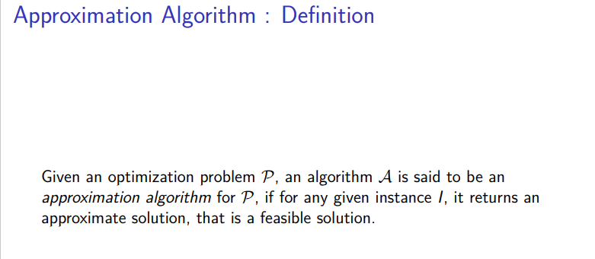
Approximation Algorithms

Slide 21
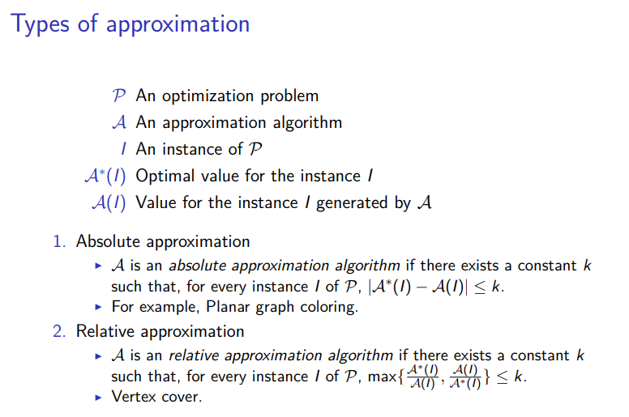
Approximation Algorithms

Slide 22
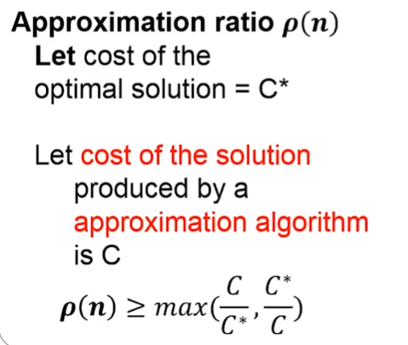
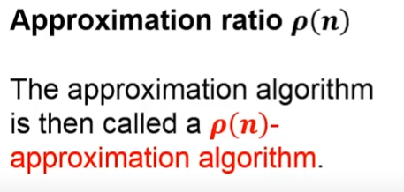
Approximation Algorithms
A(I)=C
A*(I)=C*
K=ρ(n)

Slide 23
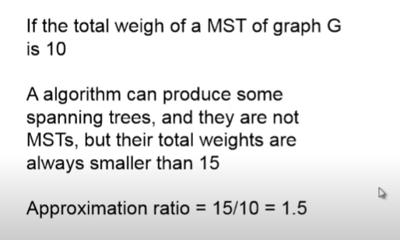
Approximation Algorithms

Slide 24
Approximation Algorithms
Some examples of the Approximation algorithm :
Here, we will discuss some examples of the Approximation Algorithm as follows.
The Vertex Cover Problem –
In the vertex cover problem, the optimization problem is to find the vertex cover with the fewest vertices, and the approximation problem is to find the vertex cover with few vertices.
Travelling Salesman Problem –
In the traveling salesperson problem, the optimization problem is to find the shortest cycle, and the approximation problem is to find a short cycle.
The Set Covering Problem –
This is an optimization problem that models many problems that require resources to be allocated. Here, a logarithmic approximation ratio is used.
The Subset Sum Problem –
In the Subset sum problem, the optimization problem is to find a subset of {x1,×2,×3…xn} whose sum is as large as possible but not larger than the target value t.

Slide 25

Approximation Algorithms

Slide 26
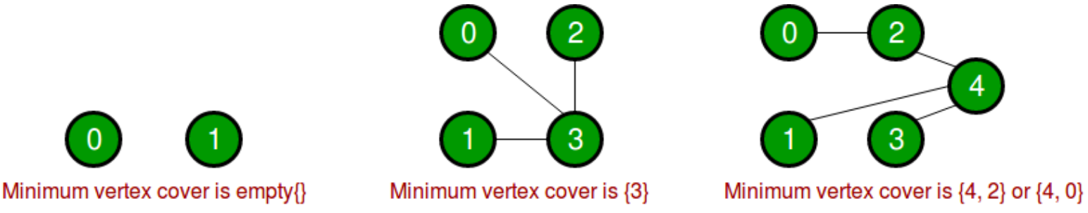
Approximation Algorithms
Introduction and Approximate Solution for Vertex Cover Problem:
A vertex cover of an undirected graph is a subset of its vertices such that for every edge (u, v) of the graph, either ‘u’ or ‘v’ is in the vertex cover. Although the name is Vertex Cover, the set covers all edges of the given graph. Given an undirected graph, the vertex cover problem is to find minimum size vertex cover.
The following are some examples.

Slide 27
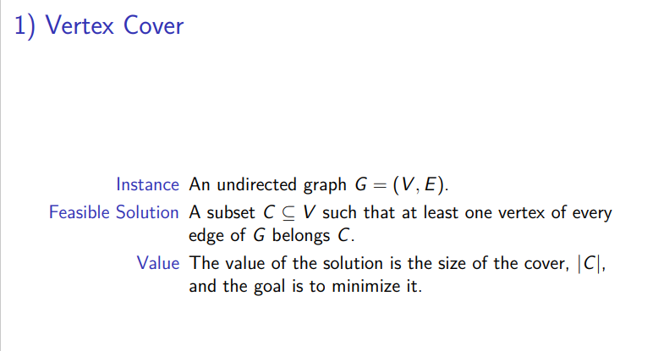
Approximation Algorithms
Vertices cover

Slide 28
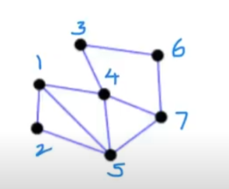
Approximation Algorithms
Vertices cover example:
Undirected graph

Slide 29
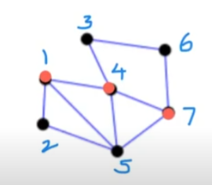
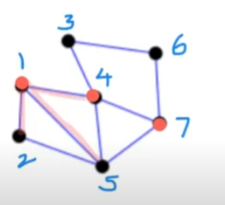
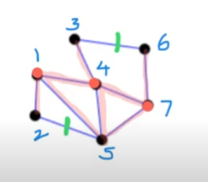
Approximation Algorithms
Vertices cover example:
Undirected graph
Suppose VC={1,4,7}
Adjacent covered edges with vertices {1}
{1,4,7} vertices are not vertices cover.
Green edges are not covered by {1,4,7}

Slide 30
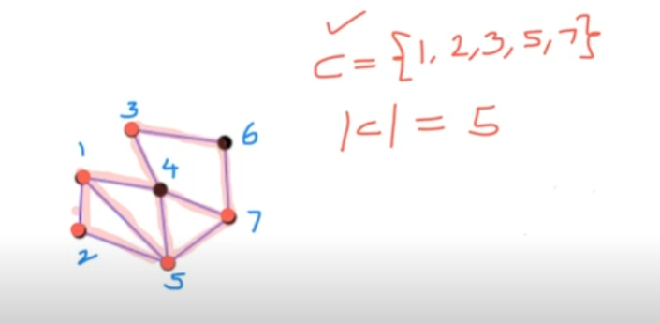
Approximation Algorithms
Vertices cover example:
Successfully covering all edges with {1,2,3,5,7}

Slide 31
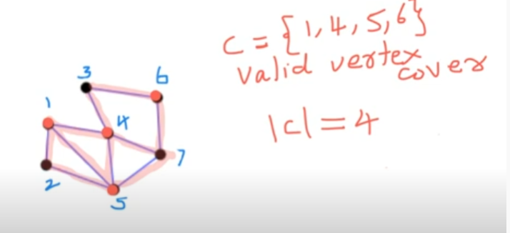
Approximation Algorithms
Vertices cover example:
Successfully covering all edges with {1,4,5,6}.
We can not find vertices cover less than 4 here.
Minimum vertices cover is 4 in this example.

Slide 32
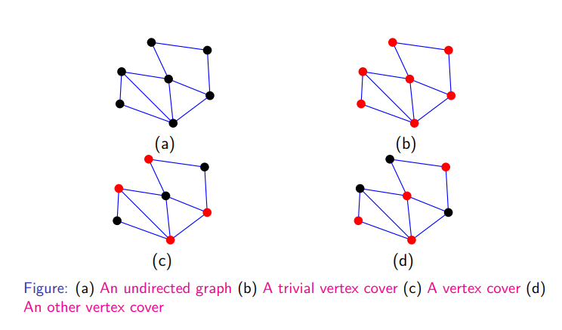
Approximation Algorithms
Vertices cover example:

Slide 33
Approximation Algorithms
Estimate the complexity of Brute-force-approach for solving vertices cover problem:
Suppose, we have n vertices {1,2,3,…………………..,n}
There are 2^{n} possible subsets from n vertices….
If we want to form vertices cover, which are minimum…..
The time complexity is Ο(2^{n} ), which is exponential in nature. The running time is exponentially increases by increasing the number of input.
For the large number of n, it takes month or year of time to compute the solution.
So, only way to approach the approximation solution……………….

Slide 34
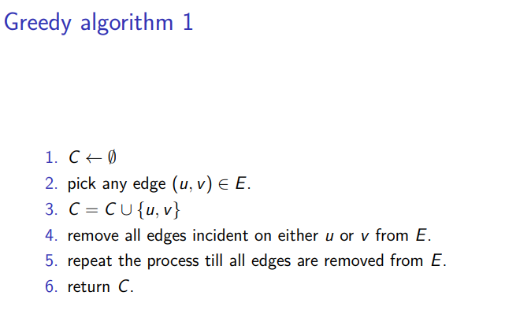
Approximation Algorithms

Slide 35
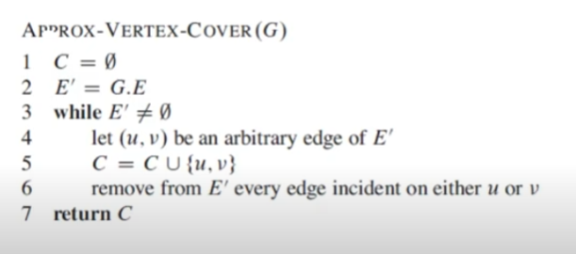
Approximation Algorithms
The time complexity Ο(V+E) = Ο(n+n²)= Ο(n²)
It’s a polynomial time complexity…….

Slide 36
Approximation Algorithms
E’ ={(1,2),(1,5),(1,4),(2,5),(3,4),(3,6)
(4,5),(4,7),(5,7),(6,7)}

Slide 37
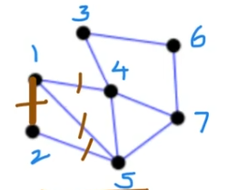
Approximation Algorithms
E’ = {(3,4),(3,6)
(4,5),(4,7),(5,7),(6,7)}
C = {1,2}

Slide 38
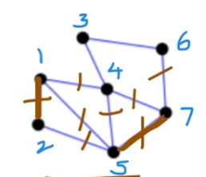
Approximation Algorithms
E’ = {(3,4),(3,6)}
C = {1,2,5,7}

Slide 39
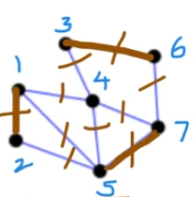
Approximation Algorithms
E’ = {φ}
C = {1,2,5,7,3,6} // They don’t share common vertices
|C| = 6

Slide 40
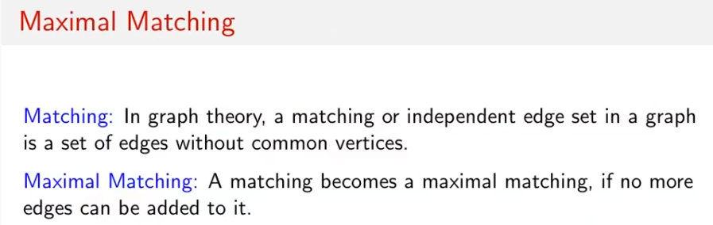
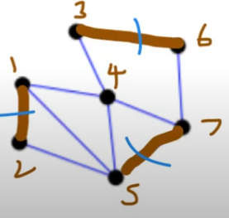
Approximation Algorithms
C = {1,2, 5,7, 3,6}
M = {(1,2), (5,7), (3,6)}
|C| = 6
|M| = 3
|C| = 2. |M|

Slide 41
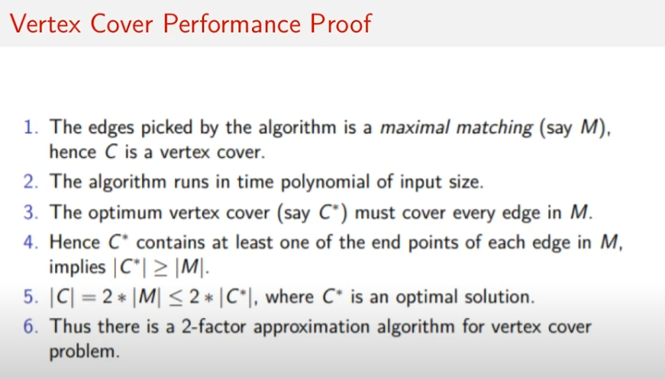
Approximation Algorithms
|C*|≥ |M|, then 2|C*|≥ 2|M|.
So |C| ≤ 2|C*| We get 6 ≤ 8

Slide 42
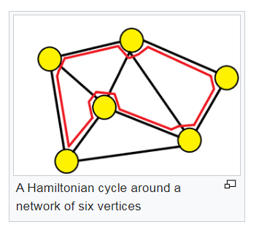
Approximation Algorithms
Traveling Sales-man Problem (TSP)
A Hamiltonian cycle is a cycle that visits each vertex exactly once. A
Hamiltonian path that starts and ends at adjacent vertices can be completed by adding one more edge to form a Hamiltonian cycle, and removing any edge from a Hamiltonian cycle produces a Hamiltonian path.
Determining whether such paths and cycles exist in graphs (the Hamiltonian path problem and Hamiltonian cycle problem) are NP-complete.

Slide 43
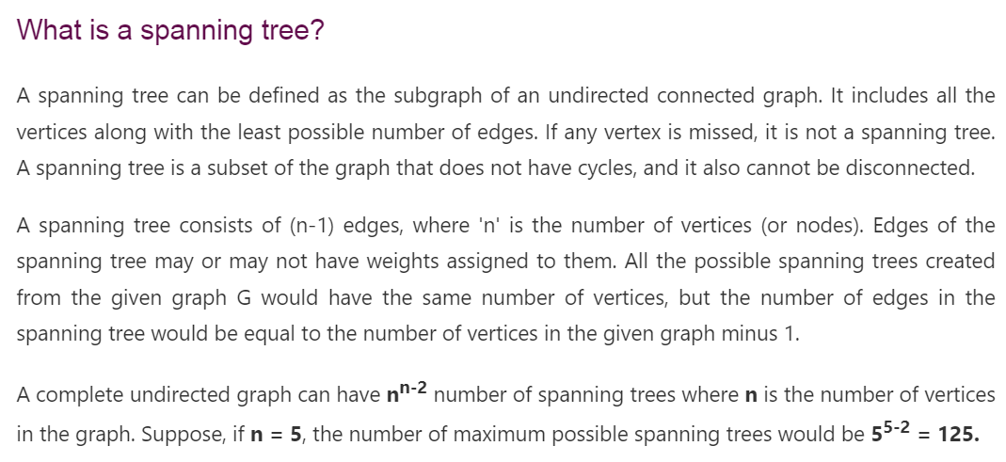
Approximation Algorithms
Traveling Sales-man Problem (TSP)

Slide 44
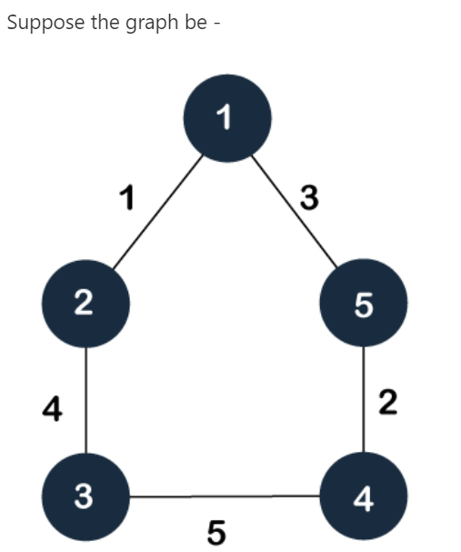
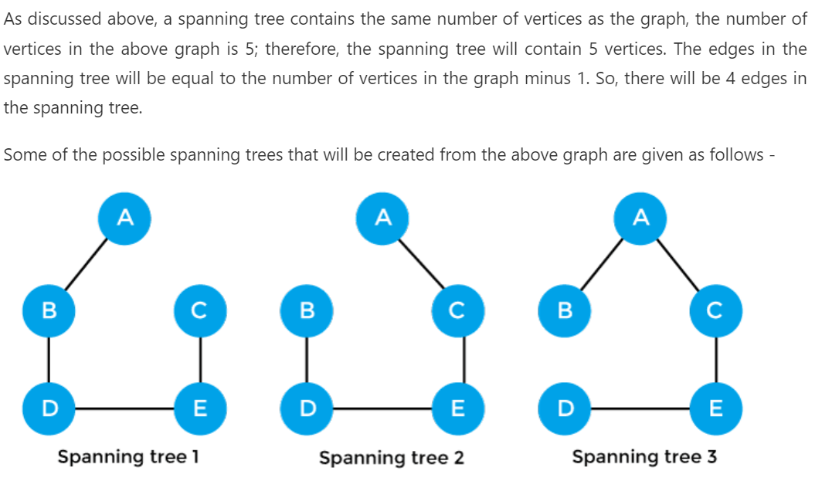
Approximation Algorithms
Traveling Sales-man Problem (TSP)
Example of spanning tree:

Slide 45
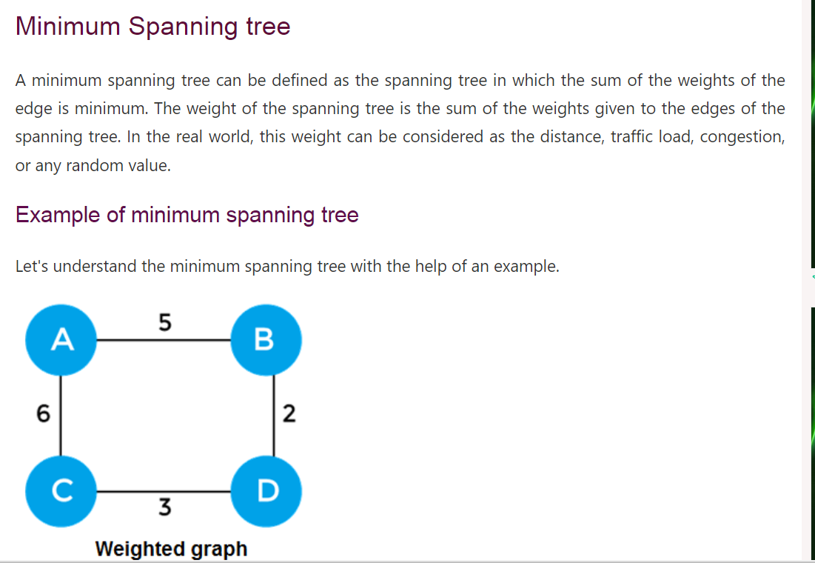
Approximation Algorithms
Traveling Sales-man Problem (TSP)

Slide 46
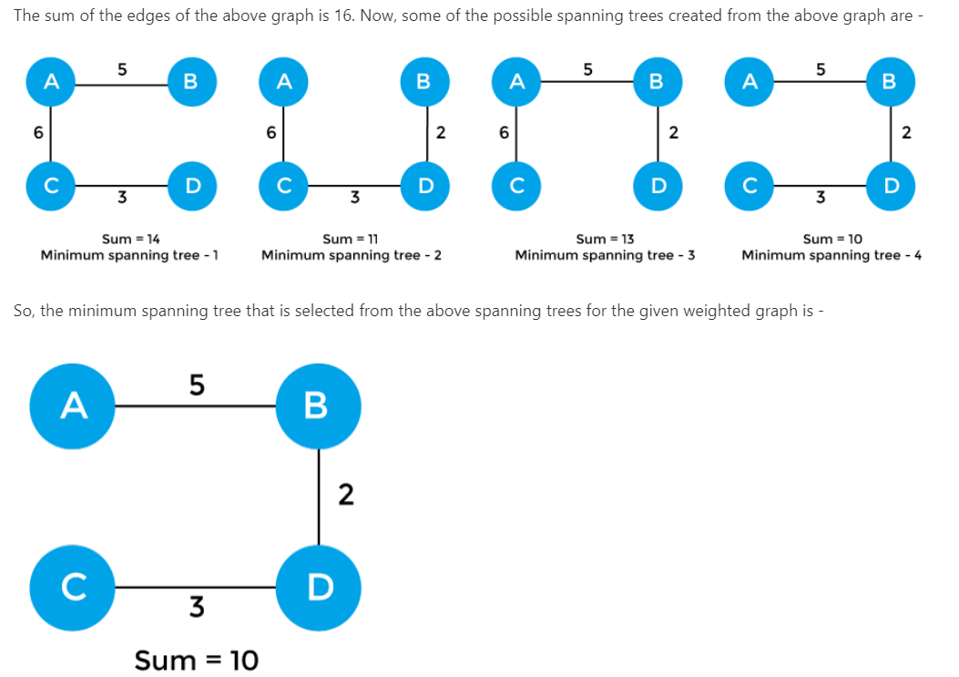
Approximation Algorithms
Traveling Sales-man Problem (TSP)

Slide 47
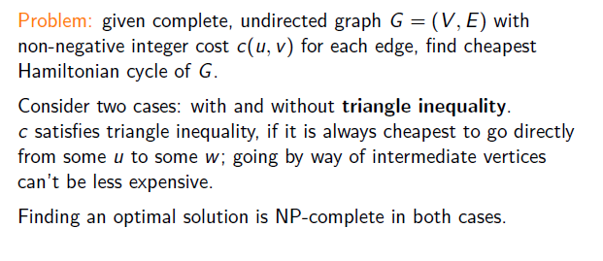
Approximation Algorithms
Traveling Sales-man Problem (TSP)

Slide 48
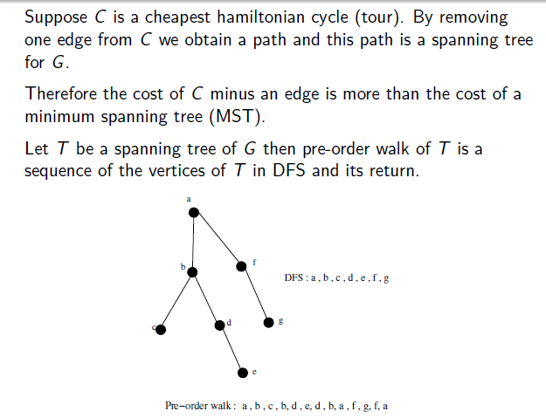
Approximation Algorithms
Traveling Sales-man Problem (TSP)

Slide 49
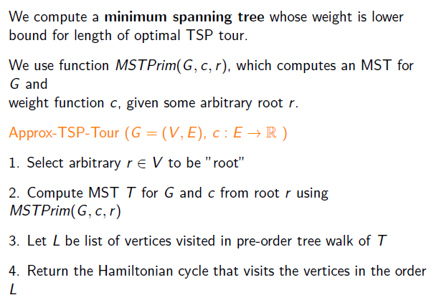
Approximation Algorithms
Traveling Sales-man Problem (TSP) with Triangle Inequality

Slide 50
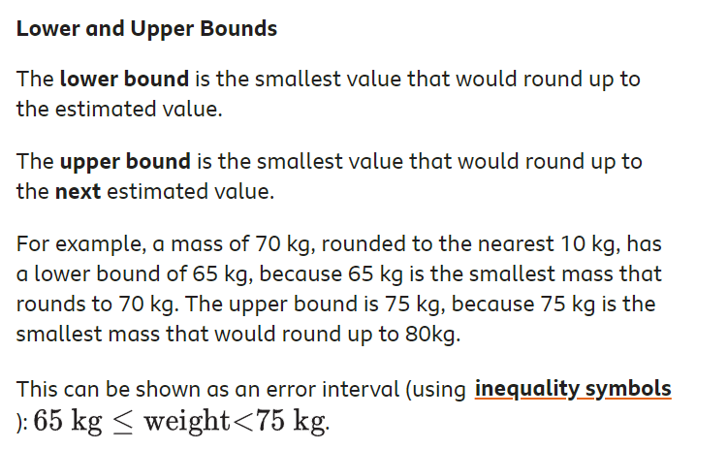
Approximation Algorithms

Slide 51
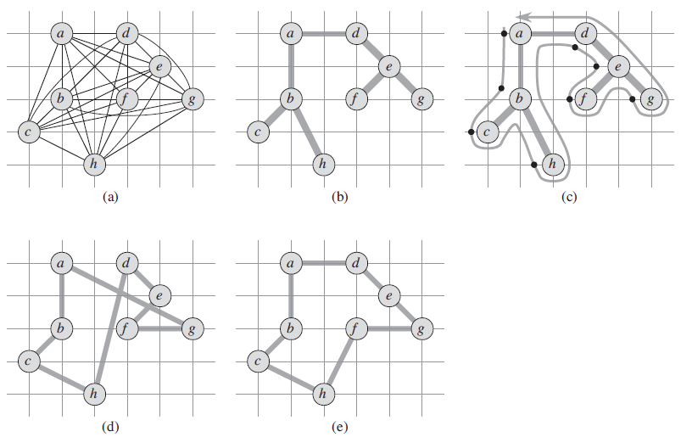
Approximation Algorithms
Traveling Sales-man Problem (TSP)

Slide 52
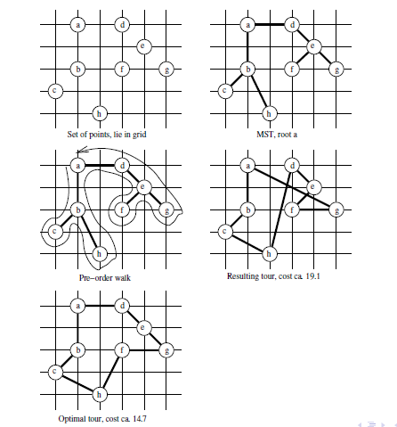
Approximation Algorithms
Traveling Sales-man Problem (TSP)

Slide 53
Approximation Algorithms
Traveling Sales-man Problem (TSP)
A complete undirected graph. Vertices lie on intersections
of integer grid lines. f is one unit to the right and two units up from h.
A minimum spanning tree T of the complete graph,
as computed by MST-PRIM. Vertex a is the root vertex.
A walk of T , starting at a. A full walk of the tree visits
the vertices in the order
a; b; c; b; h; b; a; d; e; f; e; g; e; d; a.
A preorder walk of T lists a vertex just when it is
first encountered,
yielding the ordering a; b; c; h; d; e; f; g.
A tour obtained by visiting the vertices in the order
given by the preorder walk, which is the tour H
returned by APPROX-TSP-TOUR. Its total cost is
approximately 19:074.
An optimal tour H for the original complete graph.
Its total cost is approximately 14:715.

Slide 54
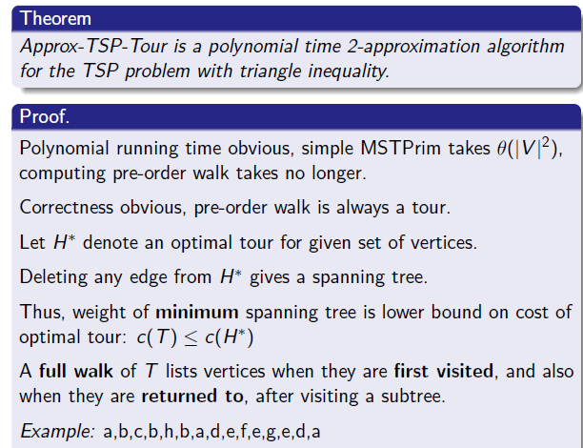
Approximation Algorithms
Traveling Sales-man Problem (TSP)

Slide 55
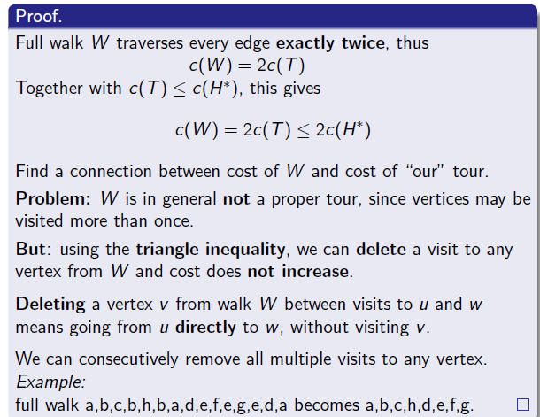
Approximation Algorithms
Traveling Sales-man Problem (TSP)

Slide 56
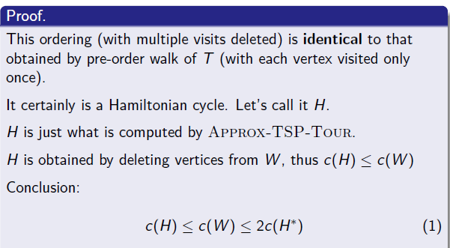
Approximation Algorithms
Traveling Sales-man Problem (TSP)

Slide 57
Approximation Algorithms
Bin Packing
The bin packing problem is an optimization problem, in which items of different sizes must be packed into a finite number of bins or containers, each of a fixed given capacity, in a way that minimizes the number of bins used.
The problem has many applications, such as filling up containers, loading trucks with weight capacity constraints, creating file backups in media, and technology mapping in FPGA semiconductor chip design.

Slide 58
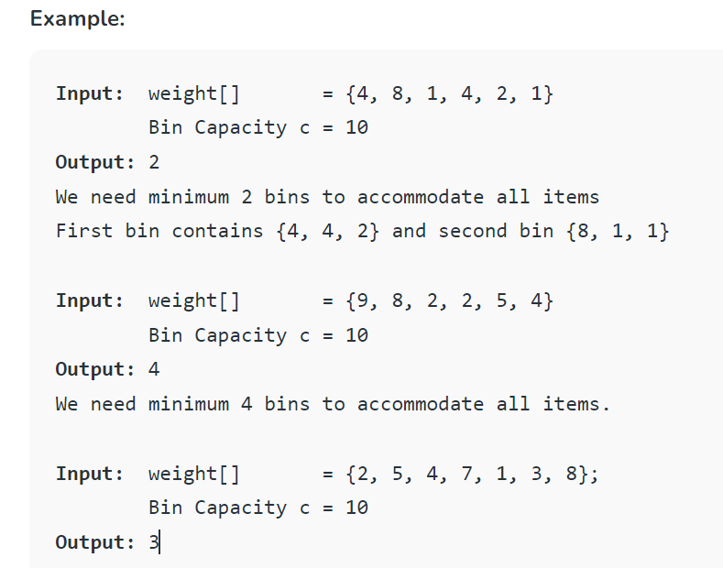
Approximation Algorithms
Bin Packing
Given n items of different weights and bins
each of capacity c, assign each item to a bin
such that number of total used bins
is minimized.
It may be assumed that all items
have weights smaller than bin capacity.

Slide 59
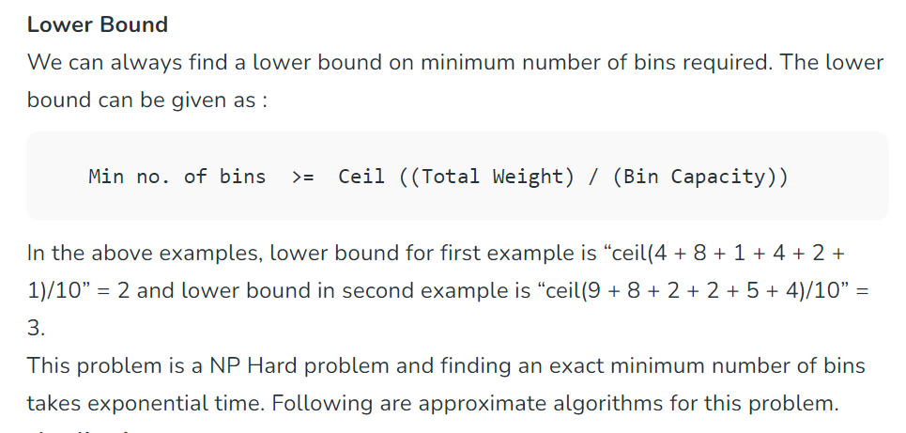
Approximation Algorithms
Bin Packing

Slide 60
Approximation Algorithms
Bin Packing
Applications
Loading of containers like trucks.
Placing data on multiple disks.
Job scheduling.
Packing advertisements in fixed length radio/TV station breaks.
Storing a large collection of music onto tapes/CD’s, etc.
Online Algorithms
These algorithms are for Bin Packing problems where items arrive one at a time (in unknown order), each must be put in a bin, before considering the next item.
1. Next Fit:
When processing next item, check if it fits in the same bin as the last item. Use a new bin only if it does not.

Slide 61
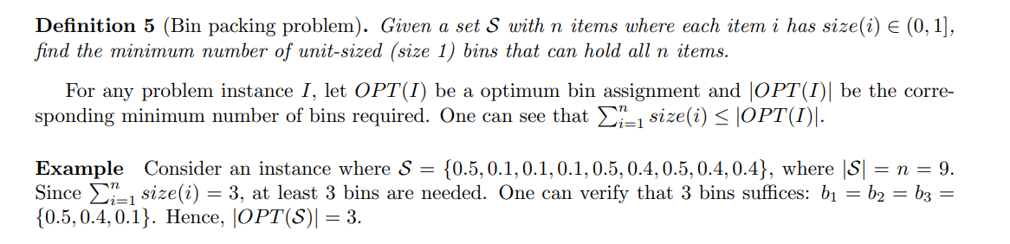

Approximation Algorithms
Bin Packing

Slide 62

Approximation Algorithms
Bin Packing

Slide 63

Approximation Algorithms

Slide 64
Approximation Algorithms
Any Question???

